Slide 1
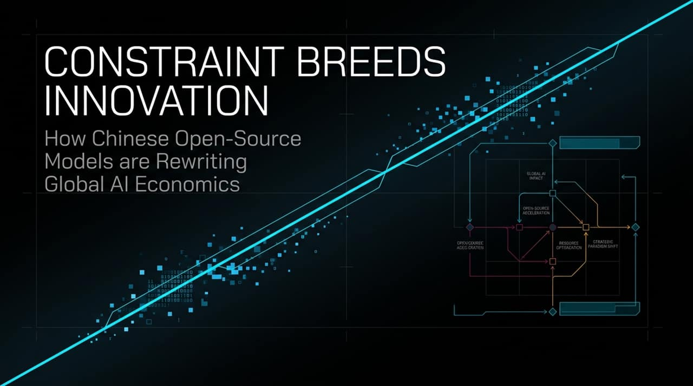
Notes:
Good morning/afternoon, everyone. Welcome to today’s presentation. Today, we’re addressing a major structural shift in the global AI landscape: how severe constraints in hardware and capital have fundamentally altered AI development strategies in China. Over the past year, open-weight and open-source releases coming out of China—such as Moonshot’s Kimi K3 and DeepSeek—have sent shockwaves through Silicon Valley. They’ve prompted serious strategic re-evaluations across frontier AI labs, developer communities, and venture capital ecosystems worldwide.
Core Thesis:
The mainstream Western narrative often assumes that frontier AI can only advance by scaling up compute power—more H100 GPUs, bigger data centers, and multi-billion-dollar training runs. However, as 5Y Capital’s Meng Xing noted in his recent interview with Silicon Valley 101, when you place extreme resource scarcity on world-class engineering talent, you force architectural efficiency rather than brute-force scaling. The constraint itself becomes the catalyst for innovation.
What We Will Cover:
Over the next 12 slides, we will dissect this dynamic across four key dimensions:
Talent & Culture: How young, agile engineering teams are beating legacy tech giants.
Architectural Breakthroughs: Innovations like KDA and Sparse Attention (DSA).
Economic Disruption: The shifting token economy and developer migration.
Vertical AI & Future Paradigms: The rise of Neolabs, AI short films, and AI for Science.
https://www.youtube.com/watch?v=HRNacC3pKSI

Slide 2
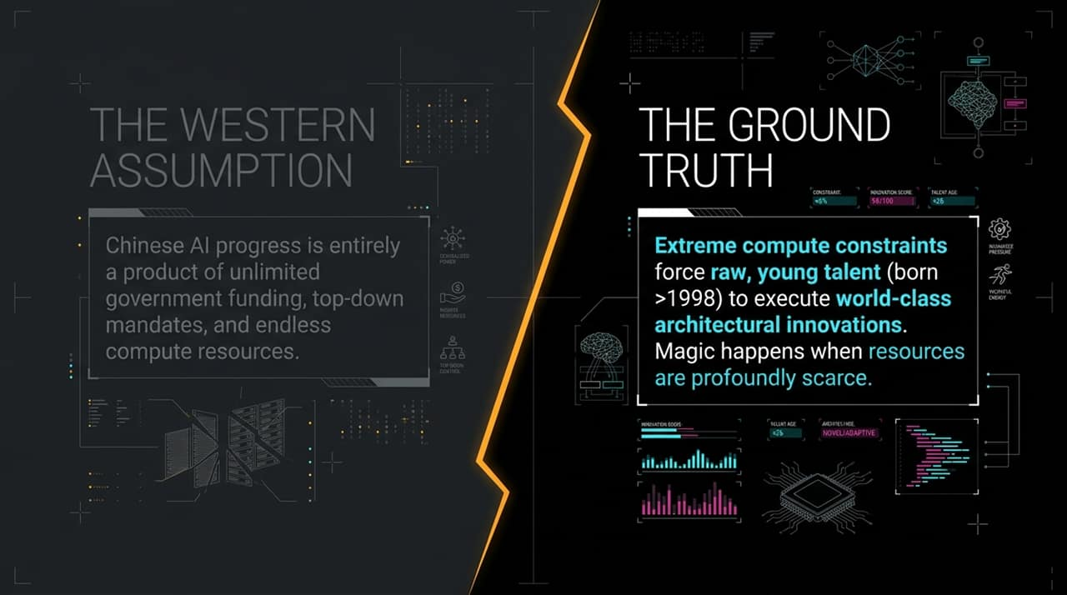
Notes:
Addressing the Misconception:
Let's start by dismantling the single biggest misconception Silicon Valley holds regarding Chinese AI. The common assumption in Western media and policy circles is that Chinese AI progress is primarily driven by state planning—unlimited government funding, top-down mandates, and endless compute resources funnelled into state-backed labs.
Revealing the Ground Truth:
The ground truth on the factory floor of these labs is completely different. These breakthroughs are driven by raw, ultra-young talent—researchers born in 1998 or later—working under intense hardware constraints. Because these labs do not have access to 100,000-card GPU clusters, they cannot simply brute-force model size or context window extensions. They are forced to rethink model architectures from the ground up.
The Engineering Takeaway:
In engineering, infinite resources can actually stifle creativity; when you have unlimited compute, you tend to default to existing transformer paradigms. But when hardware is profoundly scarce, magic happens. As Meng Xing pointed out, infrastructure engineers at top US frontier labs like OpenAI, Anthropic, and Google DeepMind are actively studying tech reports from these young Chinese researchers because they are achieving near-frontier reasoning performance at a fraction of the compute footprint.

Slide 3
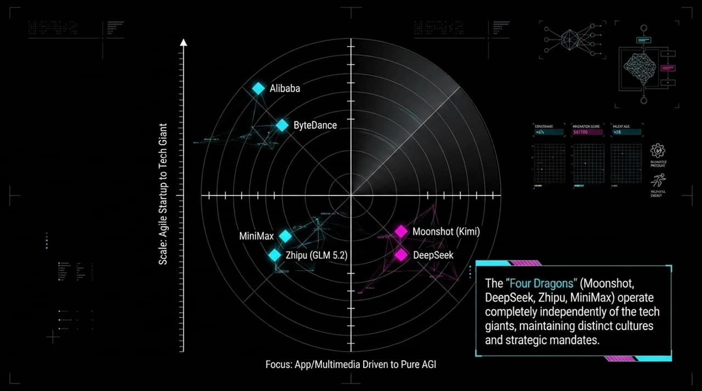
Notes:
Structure of the Landscape:
To understand China’s AI ecosystem, we must look at its market structure. Similar to the US—where you have closed-source tech giants alongside focused frontier startups—China has evolved a two-tier market. On one side are tech giants like Alibaba and ByteDance. On the other side are the independent frontier AI startups known as the 'Four Dragons': Moonshot (Kimi), DeepSeek, Zhipu (GLM), and MiniMax.
Independence and Strategic Mandates:
What makes the Four Dragons distinct is their complete operational and cultural independence from the tech conglomerates. They operate with distinct strategic mandates:
Moonshot (Kimi) & DeepSeek are laser-focused on Pure AGI and foundational reasoning capabilities.
Zhipu (GLM 5.2) has built a strong enterprise and developer footing, particularly exceling in code generation and fast adoption across developer workflows.
MiniMax leans heavily into product-led, consumer, and multimedia applications.
Talent Mobility & Organizational Dynamics:
Notice the positional positioning on this matrix. While US labs experience high researcher mobility—where senior talent hops between OpenAI, Anthropic, and Google almost monthly—Chinese labs maintain tightly knit, founder-led cultures with much lower cross-firm mobility. Each lab’s technological identity is heavily dictated by its founder’s core philosophy, enabling long-term alignment and singular focus.

Slide 4
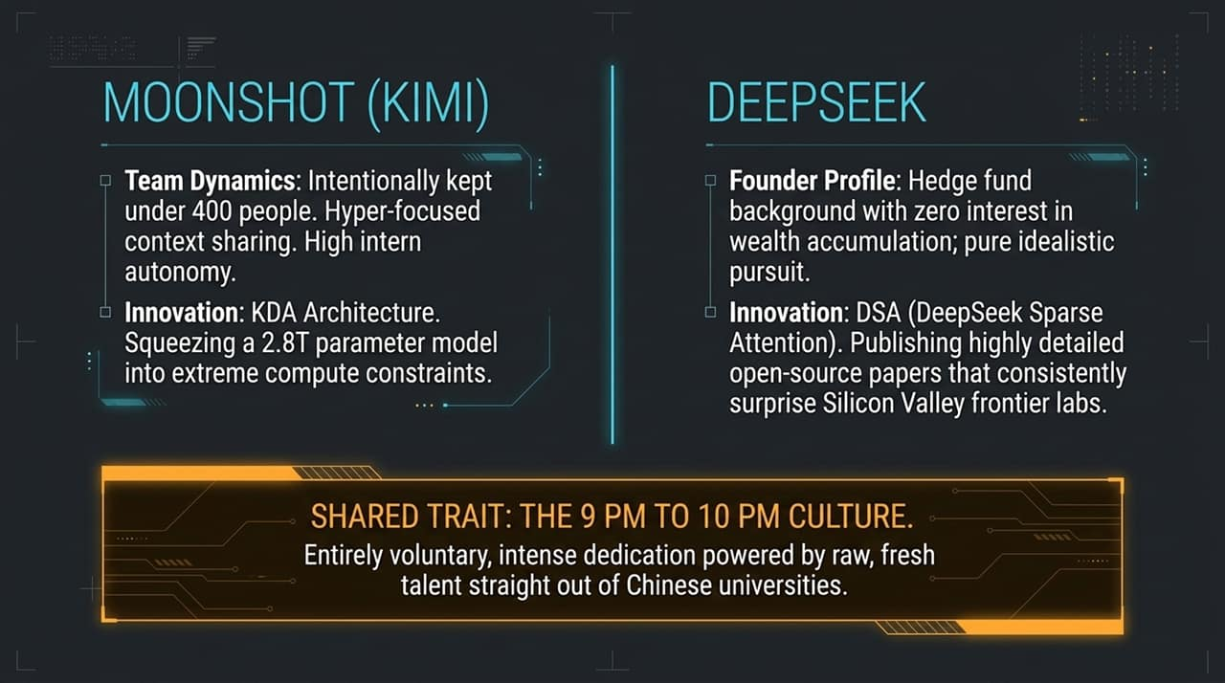
Notes:
Moonshot AI & Architectural Feats:
Let's look under the hood of Moonshot AI and DeepSeek—the two labs leading open-weight performance.
Moonshot intentionally caps its team size under 400 people. In Silicon Valley, when labs build models of Kimi K3’s caliber, people assume it takes thousands of employees. Moonshot stays small to prevent context loss across teams. They give high autonomy to very young interns. Their major breakthrough with K3 was integrating KDA Architecture into a massive 2.8 Trillion parameter model. Normally, introducing radical architectural changes at this scale destabilizes model training. Doing this on limited compute and a tight timeline was an extraordinary engineering feat.
DeepSeek & The Idealistic Founder:
DeepSeek presents an even more unusual profile. Its founder comes from a hedge fund background and operates with near-zero interest in commercial wealth accumulation. Instead, DeepSeek acts as an open-source research haven. They developed DSA (DeepSeek Sparse Attention) and publish open-source papers so detailed that researchers at Google and OpenAI rely on them to replicate complex parallel training setups.
The 9 PM to 10 PM Culture & Shared Traits:
Both labs share a crucial cultural element: the voluntary '9 PM to 10 PM culture'. This isn't corporate top-down burnout; it's intense, mission-driven dedication powered by young graduates fresh out of elite universities. They are not chasing stock options or quick liquid exits; they are driven by a pure, idealistic ambition to achieve AGI.

Slide 5
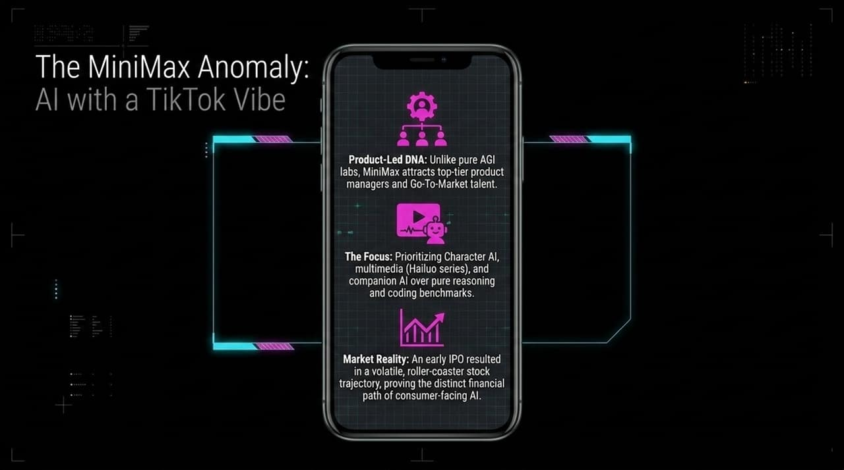
Notes:
Product-Led DNA:
Unlike Moonshot and DeepSeek—which behave like pure AGI research institutions—MiniMax represents the consumer and application-first extreme of Chinese foundation labs. MiniMax's culture feels like ByteDance or TikTok. Rather than filling their ranks strictly with theoretical computer scientists, MiniMax attracted top-tier product managers, growth hackers, and Go-To-Market talent.
Character AI & Multimedia Focus:
Their primary focus has been peripheral intelligence and rich multi-modal interaction: companion AI, virtual character platforms, and their flagship Hailuo multimedia series. While they haven't led pure reasoning benchmarks like coding or logic math, they set the standard early on for consumer companion products and video/audio generation.
Market Reality & Capital Path:
MiniMax went public early in Hong Kong, experiencing a volatile roller-coaster trajectory. This highlights a distinct financial path: consumer-facing AI models face massive consumer retention pressure and immediate monetization demands, unlike pure foundation labs backed by multi-year private venture capital runways.

Slide 6
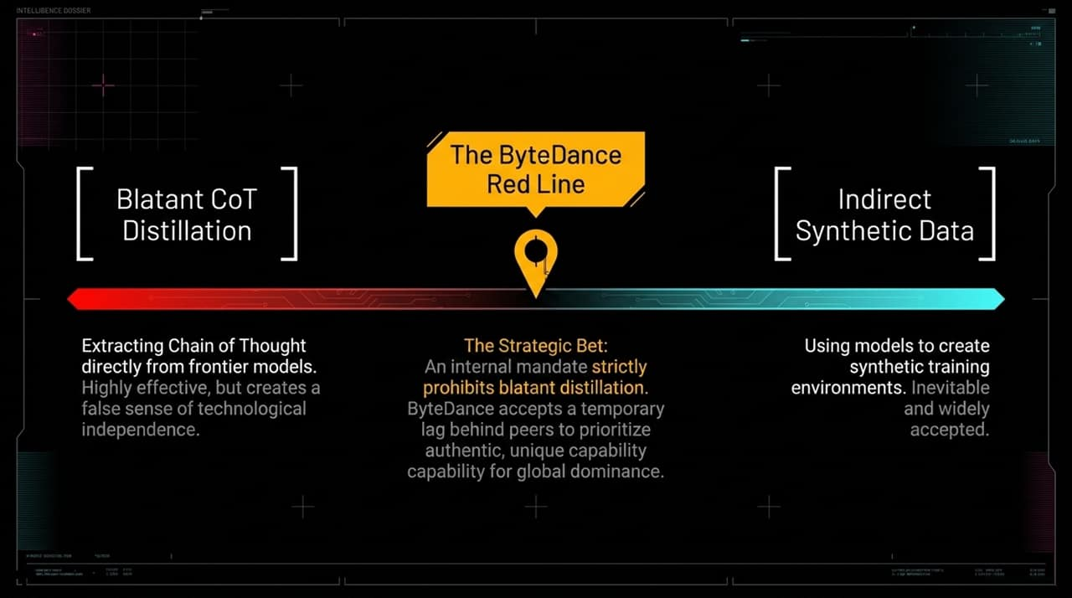
Notes:
The Distillation Spectrum:
As Chinese open-source models rapidly closed the performance gap with Western frontier models like GPT-4 and Claude, a heated debate emerged over Distillation. We need to separate distillation into two categories:
Blatant Chain-of-Thought (CoT) Distillation: Sending prompt distributions to Western models (like Claude or GPT) and directly extracting their internal reasoning traces to train smaller student models. This is highly effective in the short term, but it creates a false sense of technological independence.
Indirect Synthetic Data: Using models to generate synthetic training environments. This is universal across all modern AI training.
ByteDance’s Strategic Mandate:
The most significant strategic move recently came from ByteDance. CEO Zhang Yiming established a firm internal red line prohibiting blatant distillation. His directive was clear: even if prohibiting distillation causes ByteDance’s large language models to temporarily lag behind Chinese peers, they must accept that delay.
The Strategic Rationale:
Why take this risk? Because shortcutting via distillation gives teams a false sense of satisfaction. It prevents researchers from developing true, original pre-training capabilities. As a multi-billion-dollar enterprise with infinite runway, ByteDance can afford to sit back for a year or two to ensure that when they hit the top, it is on proprietary, ground-up architecture.

Slide 7
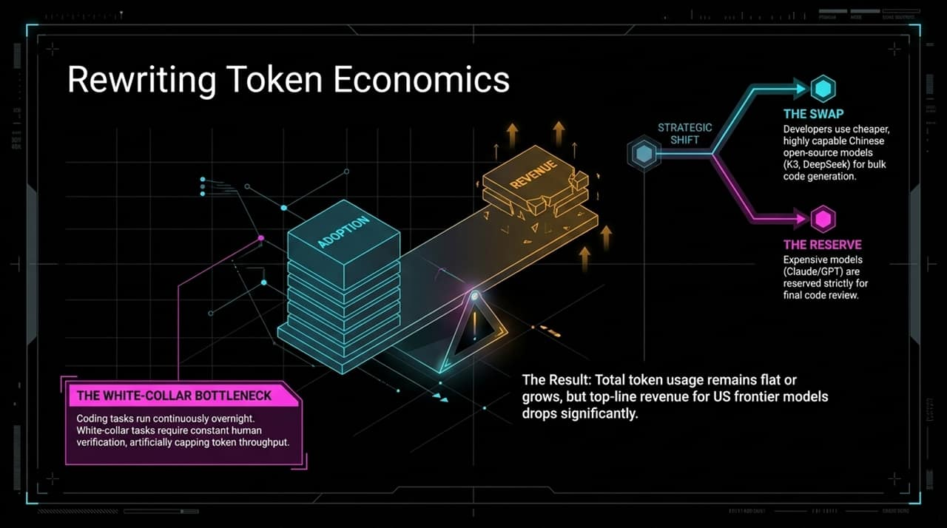
Notes:
The Changing Token Landscape:
The rapid rise of ultra-cheap, highly capable open-weight models from China is actively reshaping global AI economics. During Meng Xing’s visit to Silicon Valley, agent developers reported a major shift in how enterprise and developer teams route their LLM calls.
“The Swap” vs. “The Reserve”:
Developers have implemented a two-tier economic strategy:
The Swap: Developers shift bulk, high-volume operations—such as initial code generation, draft translation, and daily data transformation—to cheap Chinese open-source API endpoints like DeepSeek or Kimi K3.
The Reserve: Expensive frontier models (like Claude 3.5 Sonnet or GPT-4o) are reserved strictly for final code review, complex architecture checks, or safety verifications.
The White-Collar Bottleneck & Revenue Impact:
This model-swapping has led to a major financial dynamic: total global token consumption continues to grow, but top-line API revenues for Western frontier labs are stagnating or dropping. Why? While coding agents run continuously overnight without human intervention, white-collar tasks (writing decks, legal reviews, administrative summaries) require constant human verification. This human-in-the-loop bottleneck keeps token throughput low for general business apps, while bulk developer tokens migrate straight to low-cost open-source alternatives.

Slide 8
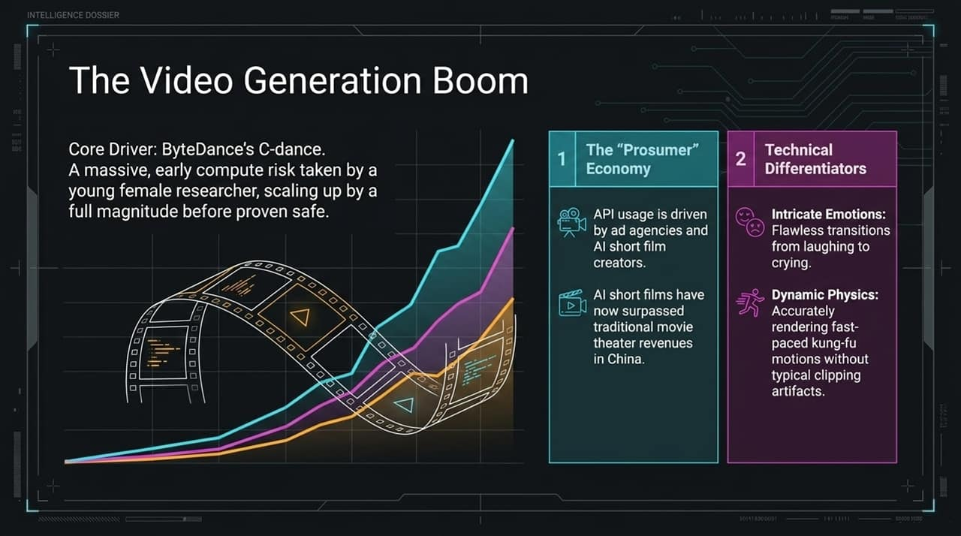
Notes:
ByteDance’s Compute Gamble:
Turning to multimedia, Chinese AI labs—led by ByteDance’s SeaDance—have taken a dominant global lead in generative video. A year ago, scaling video models required an aggressive compute bet. While Western labs paused or throttled public video model scaling (such as OpenAI delaying Sora updates), a young female researcher at ByteDance led a bold initiative to scale up compute by an entire order of magnitude before safety and output were fully proven.
Technical Differentiators:
SeaDance 2.0 solved two major technical problems that plagued earlier generative video models:
Intricate Micro-Emotions: Flawless, smooth transitions across complex emotional spectrums (e.g., transitioning smoothly from laughing to crying in a single shot).
Dynamic Physics & High Action: Accurate rendering of fast-paced martial arts and action scenes without limb clipping or spatial distortion.
The Prosumer Market Takeoff:
This visual performance created a booming 'Prosumer' economy. API usage for SeaDance is driven by advertising agencies, digital content creators, and AI short-film studios. In China, revenues from AI short films have now surpassed traditional box office theater revenues, creating a self-sustaining commercial ecosystem.

Slide 9
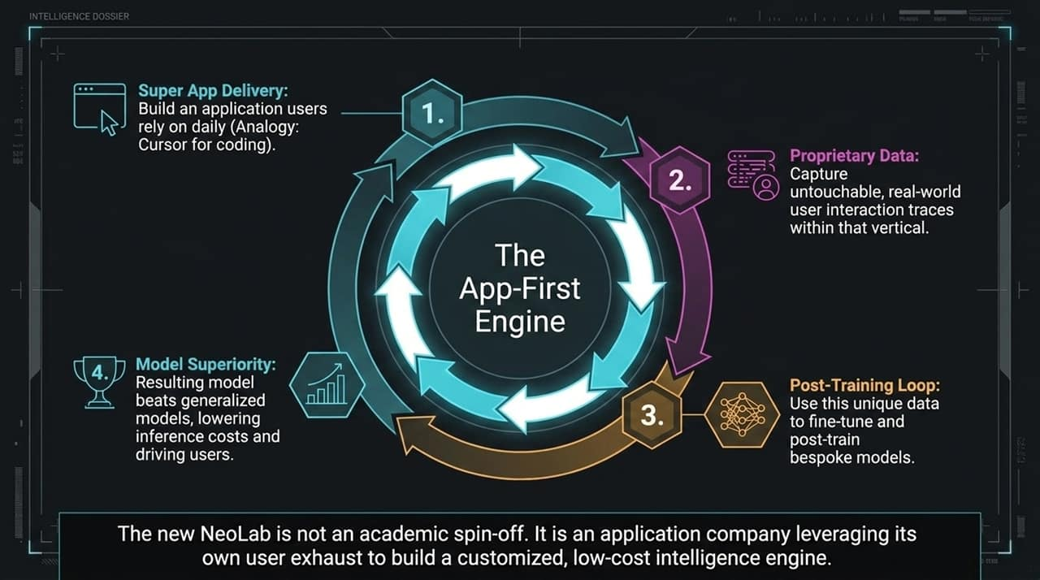
Notes:
Redefining the Neolab Concept:
In Silicon Valley, a 'Neolab' traditionally meant an academic spin-off where top researchers raise tens of millions to build new foundational models from scratch. In China, the Neolab definition is more pragmatic and application-driven.
The Cursor Flywheel Model:
The modern Neolab looks like Cursor:
Super App Delivery: You begin by building an indispensable vertical application that users interact with daily.
Proprietary Data: Through daily usage, you capture real-world user interaction traces that cannot be scraped from the web.
Post-Training Loop: Instead of expensive pre-training, you use this unique interaction data to post-train and fine-tune open-source base models.
Model Superiority: Your customized, domain-specific model beats generalized models in both task accuracy and inference cost.
Vertical Moats:
Whether in legal tech, medical diagnostics, or enterprise devops, future AI moats won't belong to teams with generic web-crawled data. They will belong to application-first engines that convert user interaction exhaust into domain-specific intelligence.

Slide 10
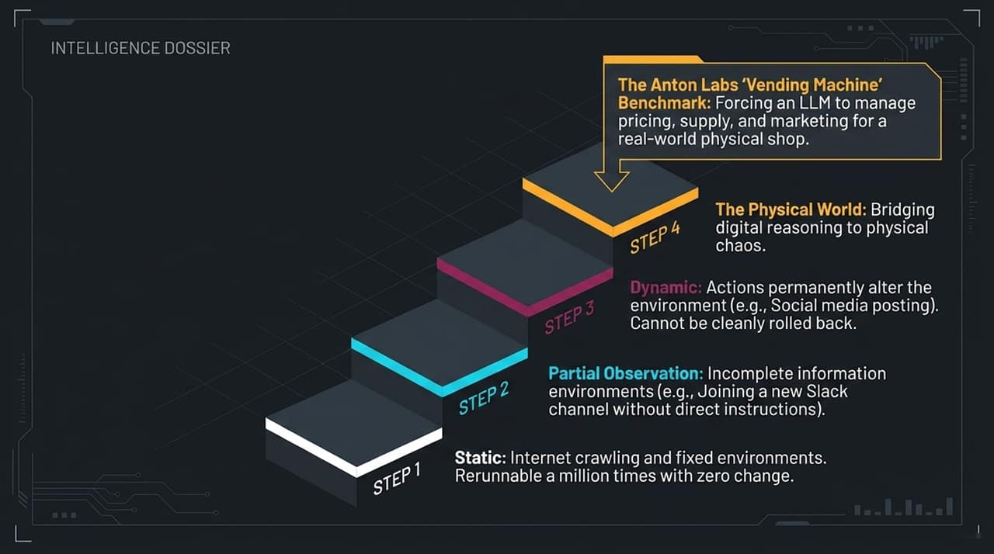
Notes:
Moving Beyond Static Internet Benchmarks:
To train autonomous agents, static internet text is no longer sufficient. Modern data providers are pivoting toward building dynamic environments.
The Anton Labs 'Vending Machine' Benchmark:
A prime example of this is Anton Labs’ 'Vending Bench'. They forced an LLM to completely manage pricing, inventory, supply chain logistics, and marketing strategies for real-world physical vending machines and retail shops.
Key Environmental Challenges:
This benchmark highlights two critical challenges that static benchmarks miss:
Partial Observation: In real business environments, information is incomplete. The model must learn to infer hidden variables through trial and interaction.
Dynamic Irreversibility: In a static test, you can roll back code a million times. In the physical world, setting an incorrect price or launching a bad marketing campaign permanently alters customer behavior. Bridging LLM reasoning to physical chaos is the next frontier for agent data.

Slide 11
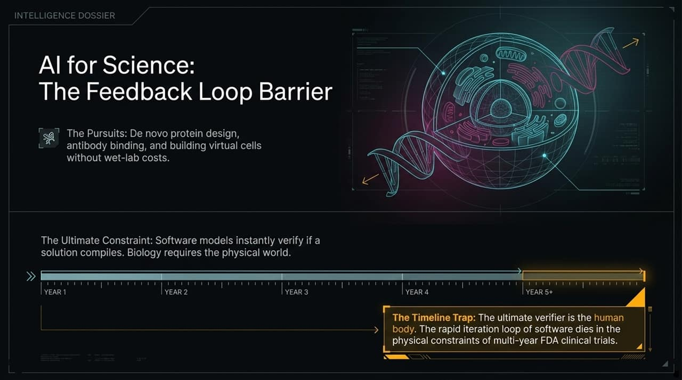
Notes:
The Promise of AI for Science:
AI for Science—spanning protein design, antibody binding, and material synthesis—is a major focus for global venture capital. Models like AlphaFold 3 and Chai enable de novo protein design without expensive wet-lab iterations.
The Verification Bottleneck:
However, AI for Science faces a structural barrier that software models do not: The Feedback Loop Barrier. In software, if an LLM writes code, a compiler verifies whether it works in seconds. In biology, your ultimate verifier is the human body.
The Timeline Trap:
You can design a novel antibody binding model in seconds, but validating whether that drug safely cures a human disease requires multi-year FDA clinical trials. The rapid iteration loop that drives software AI dies in the physical constraints of biology. Building virtual cell models to simulate drug interactions is our best attempt to bridge this gap, but data scarcity in biology remains a primary bottleneck.

Slide 12
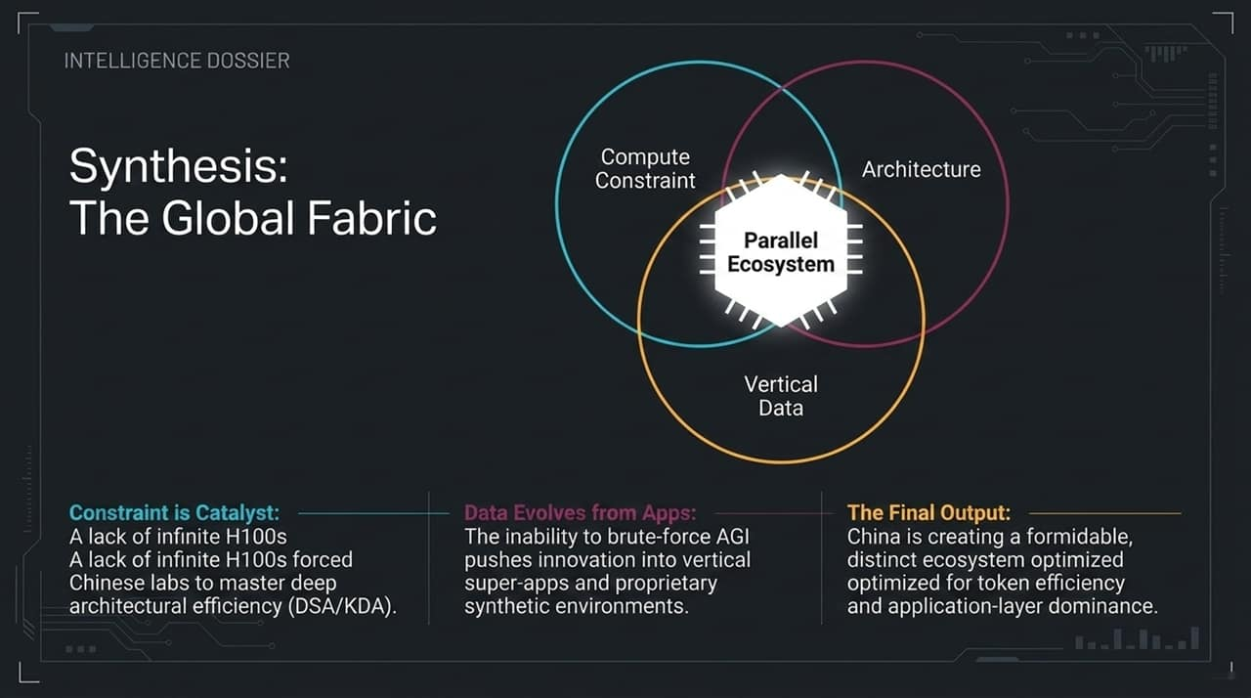
Notes:
Summarizing Key Drivers:
To synthesize our analysis today, China’s AI landscape is not merely trailing Western frontier models; it is evolving into a distinct, parallel ecosystem optimized for a different set of economic reality.
The Three Strategic Pillars:
Constraint as Catalyst: Severe compute scarcity forced Chinese labs to master deep architectural efficiency (such as DeepSeek’s DSA and Kimi’s KDA) rather than relying on hardware scale.
Data Evolves from Apps: Inability to brute-force general AGI is driving focus into vertical super-apps and proprietary interaction environments.
Parallel Architecture: China is creating an open-weight ecosystem optimized for extreme token efficiency, low inference costs, and application-layer dominance.
Concluding Outlook:
As developers worldwide continue adopting these high-efficiency open-source models, the global economics of AI will continue shifting away from high-margin API monopolies toward hyper-efficient, application-specific intelligence.

Slide 13
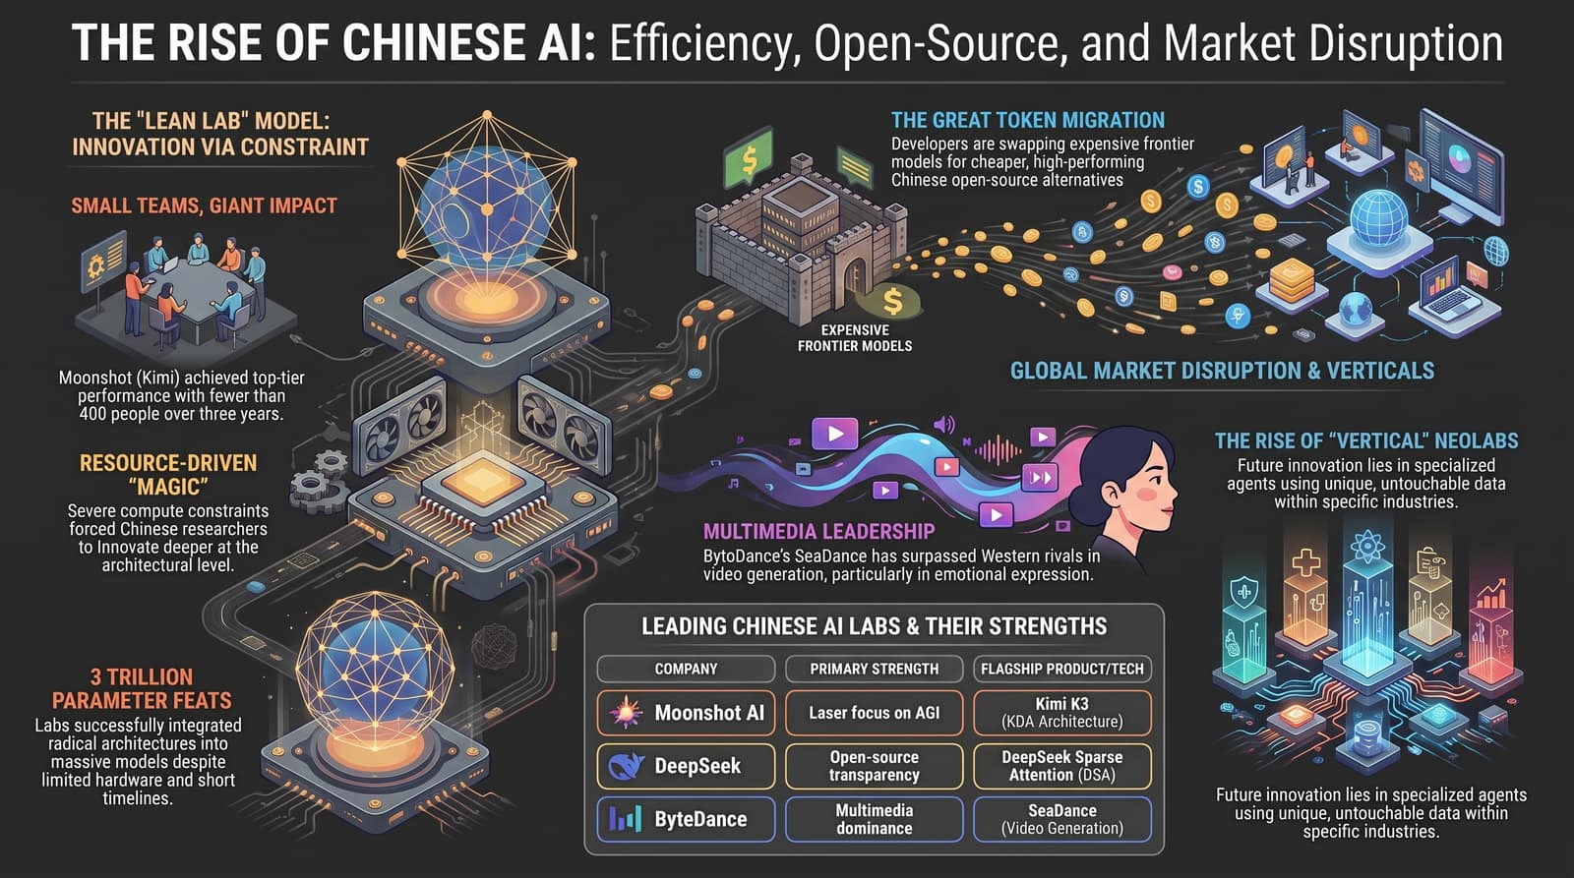
Notes:
Executive Dashboard Overview:
To wrap up our deck, this executive summary dashboard brings together the core operational metrics and strategic shifts we’ve discussed:
The Lean Lab Model: Moonshot AI reached top-tier global reasoning capabilities with fewer than 400 people.
The Token Migration: Global developers are actively swapping expensive closed models for cheaper, high-performing open-source alternatives for bulk tasks.
Multimedia Leadership: Tools like ByteDance’s SeaDance lead globally in video generation, emotional fidelity, and dynamic action physics.
Closing Call to Action & Q&A:
Whether you are an investor, developer, or enterprise strategy leader, the key takeaway is clear: do not measure AI competitiveness purely by raw GPU counts or top-down government subsidies. Watch the architectural efficiency, the open-source token adoption, and the vertical application loops.
Thank you for your time. I will now open the floor to any questions.

